Slide 1
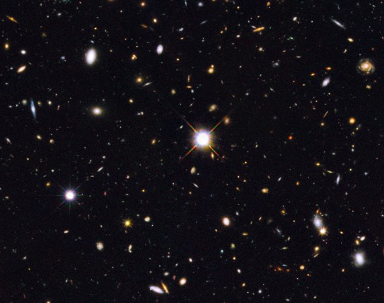
Characterizing High [OIII]/[OII] and High [OIII] Galaxies to Further LyC Study
Alex Blanche
Mentors: Dr. Brent Smith, Dr. Rogier Windhorst
Arizona Space Grant Symposium
April 17th, 2021

Slide 2
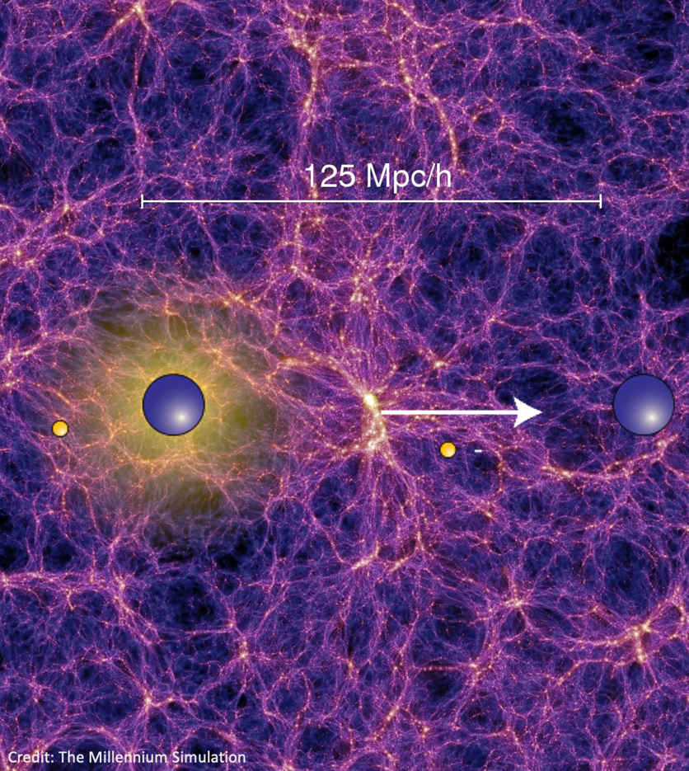

Background
The Universe is ionized
  The inter-galactic medium (IGM) is composed of low-density, ionized hydrogen
Theorized sources for reionization:
  Massive stars in early galaxies
  Super massive black holes
Lyman Continuum photons (LyC)
  Enough energy to ionize Hydrogen.
Galaxies that have strong [OIII] and [OII] emission lines frequently emit LyC compared to other galaxies (Fletcher et al. 2018)

Slide 3
Purpose
Data Set
Categorize and identify [OIII]/[OII] galaxies
Identify additional spectra needed to measure LyC emissions
Fit [OIII]/[OII] lines in order to calculate line flux
Spectra drawn from TKRS, MOSDEF, FORS2, GMASS, MUSEW, VANDELS, VIMOS, UVCANDELS, GSVUDS, VVDS, COSMOS10k, COSMOSVUDS, COSMOSmagellan, and the spectroscopic survey of the GOODS-N field published in Barger et al. 2008.
Redshift between 2.30 < z < 4.30
Initial catalog of 1103 categorized spectra filtered down to 723
47 spectra with [OIII] and/or [OII] lines

Slide 4
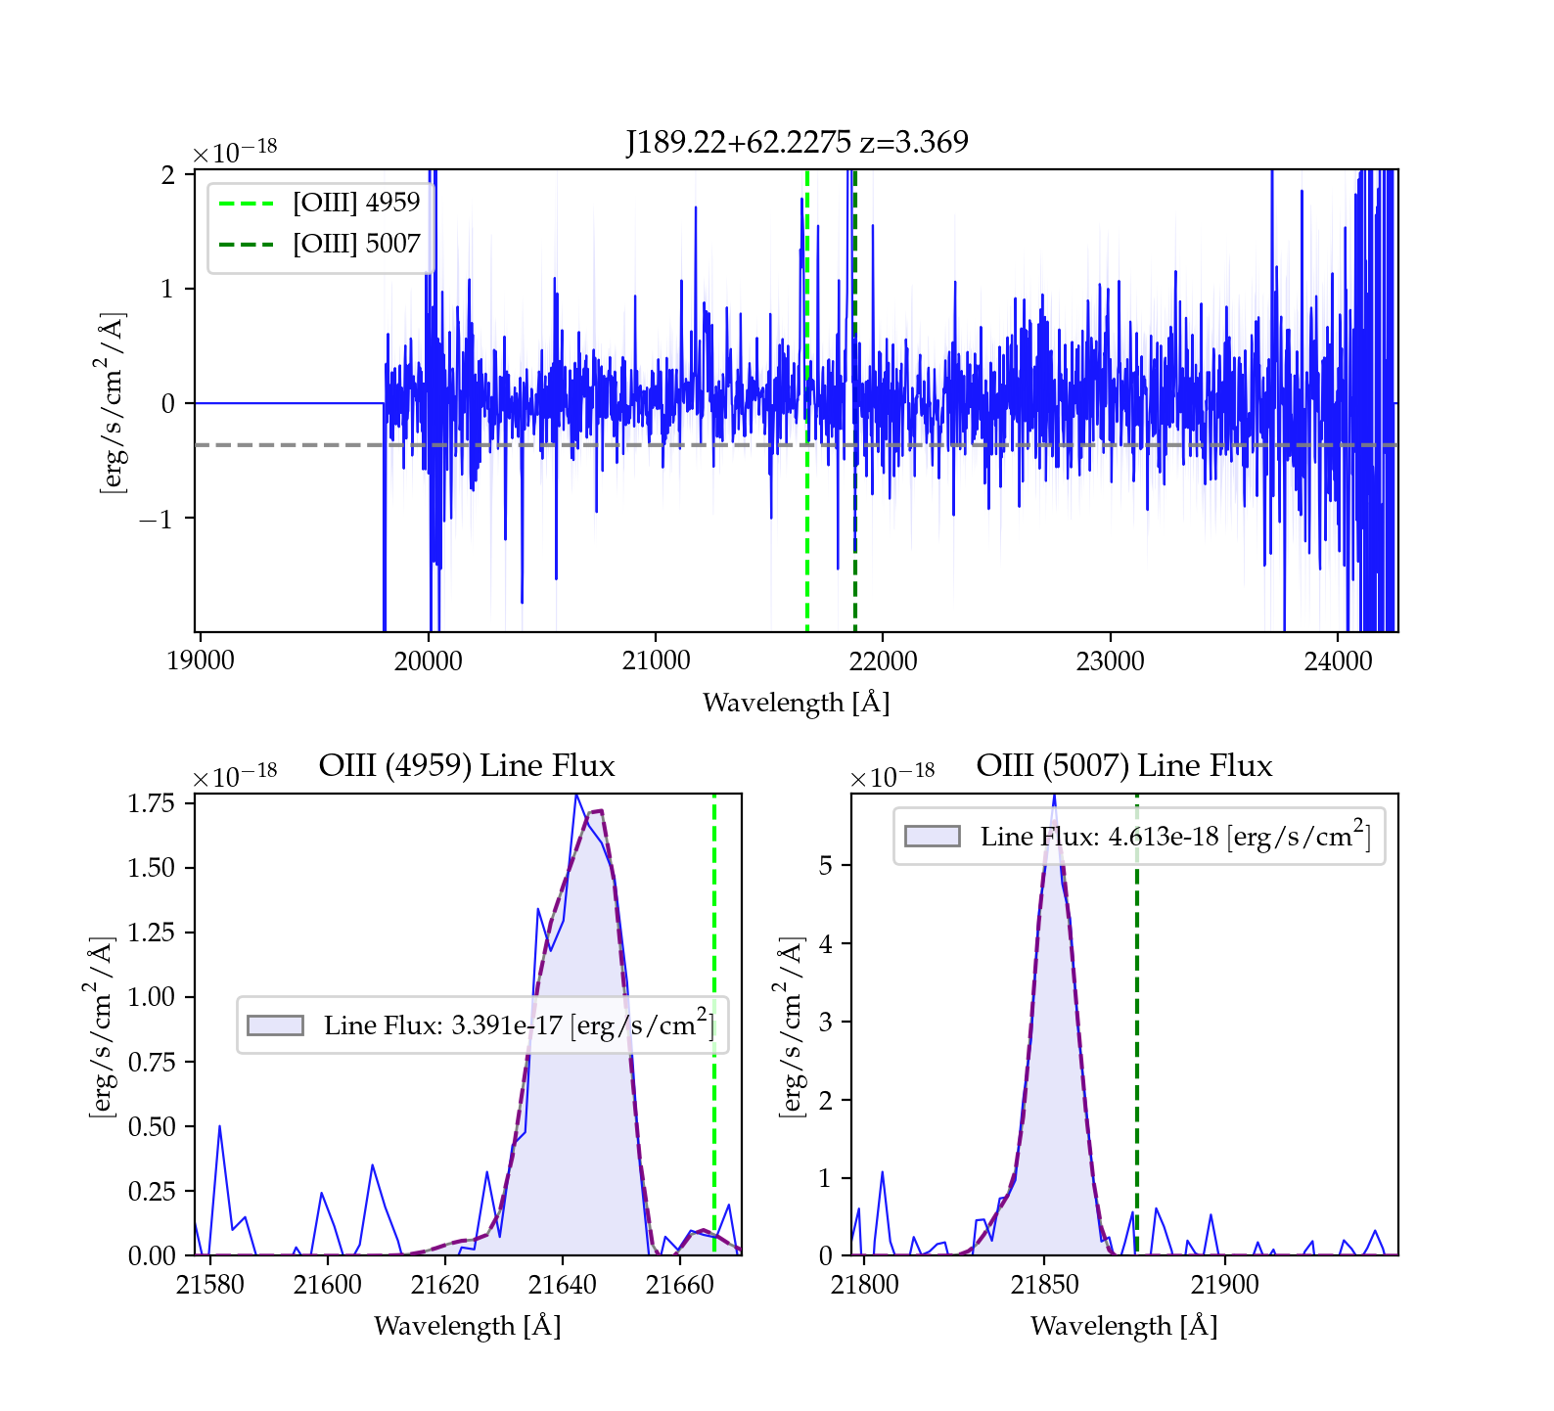
Data and Methods
Difference in [OII] (3727) and [OIII] (4959/5007) wavelengths and range of the spectra, means no object has both [OIII] and [OII] lines in its primary spectrum
Secondary spectrum or HST GRISM spectrum needed
Spectra categorized based on [OIII]/[OII] presence, spectra quality, and image availability
Spectra files synced between original and updated catalog
Line flux calculated by integrating under Gaussian-Hermite line fit
Standard deviation and power fit also calculated

Slide 5
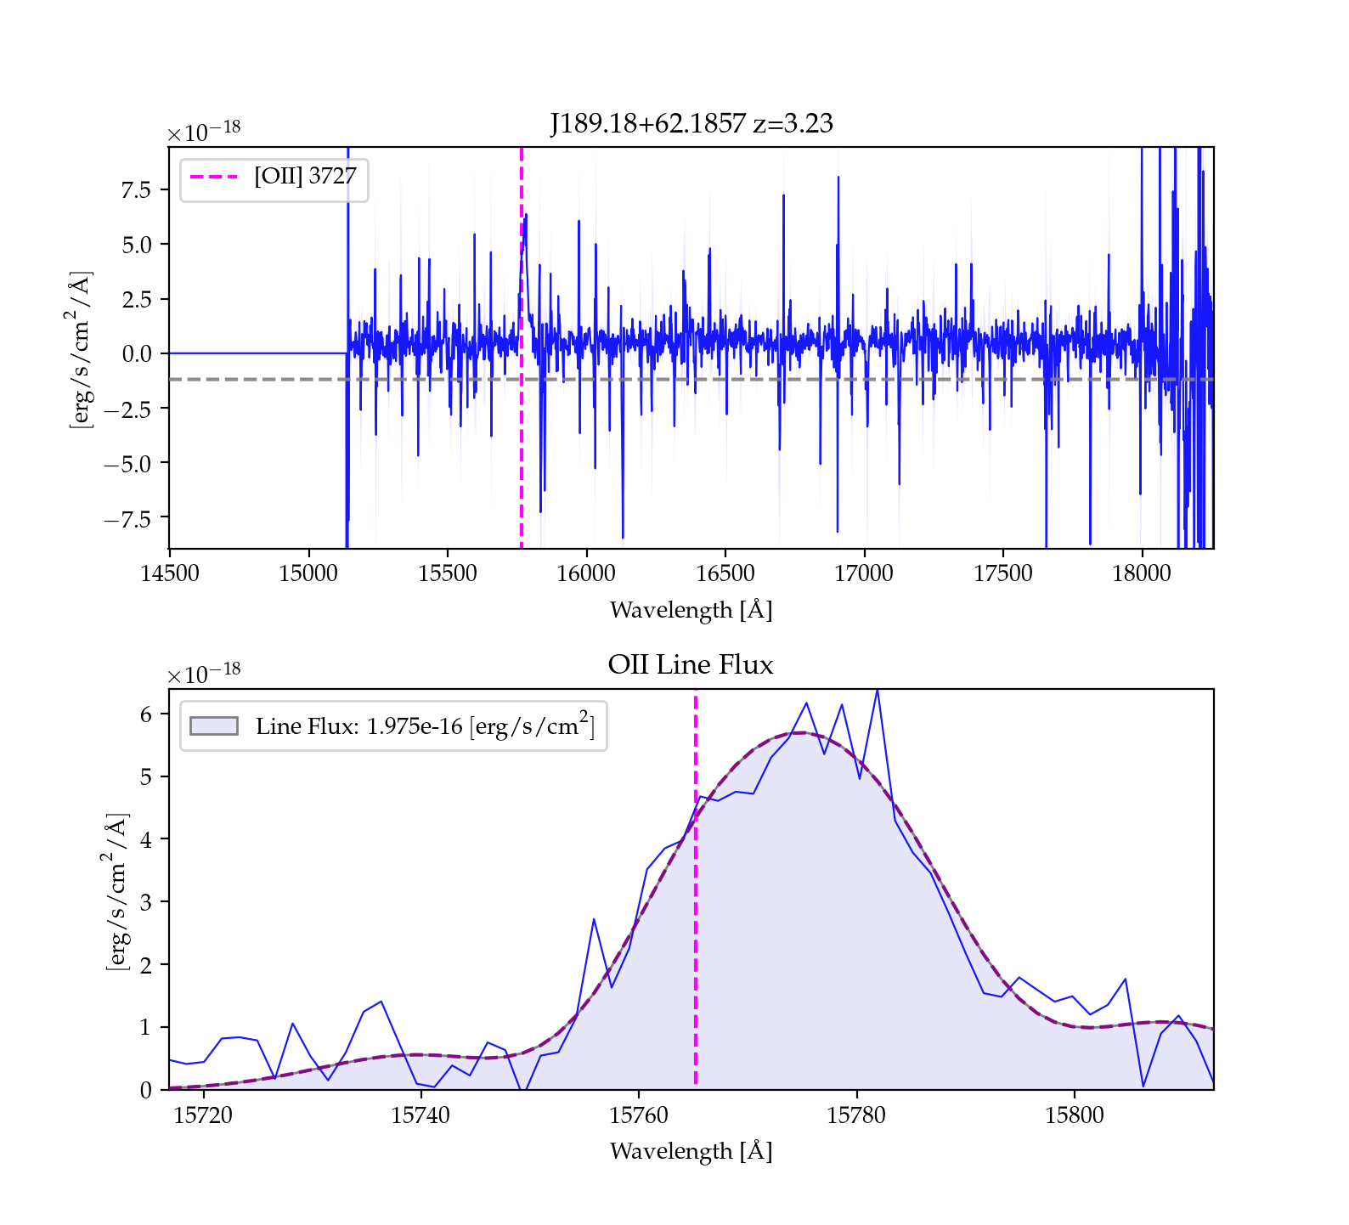
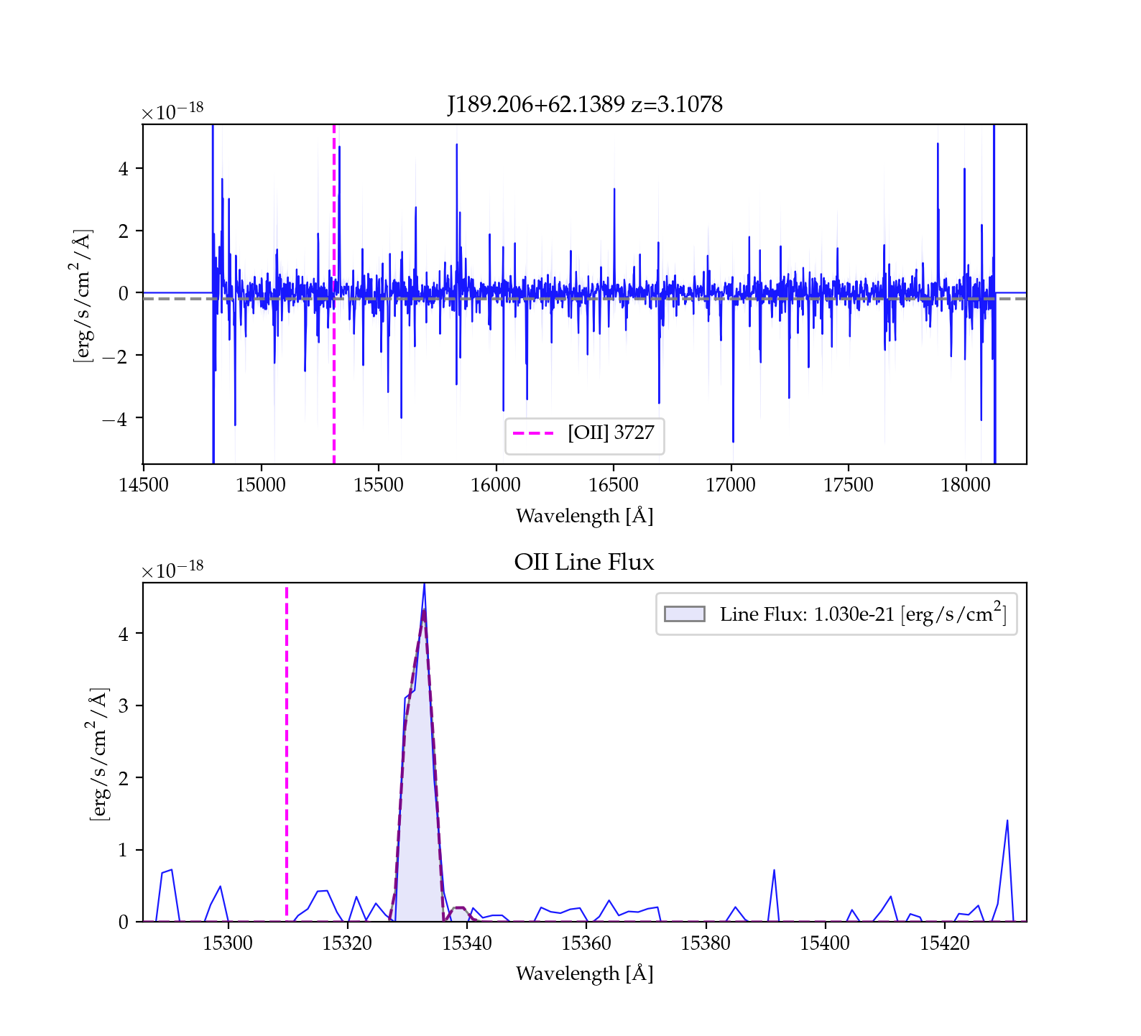

Slide 6
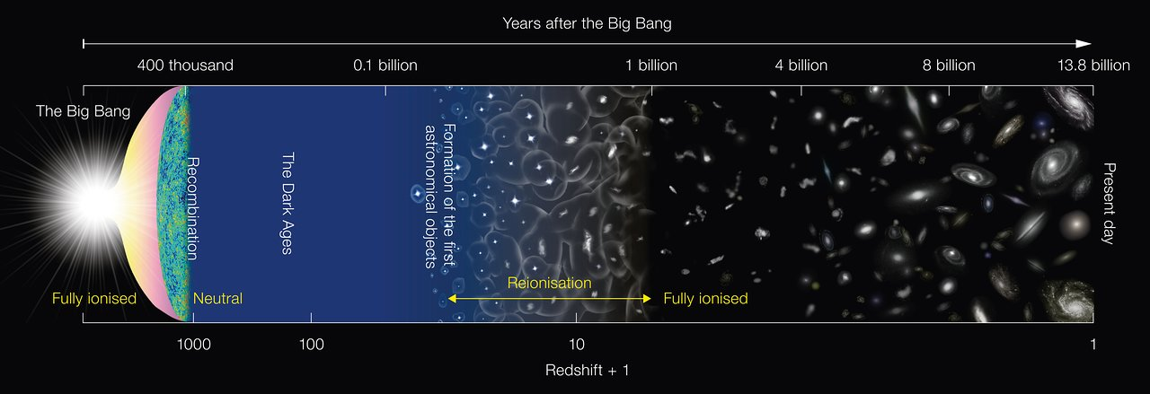
What happened here?
How did we get here?
Credit: NAOJ
Notes:
What objects reionized and how?

Slide 7
Future Work
Extracting physical parameters from line-flux measurements
  Star-formation rate from [OII] line flux
  Electron temperature from [OIII] line flux
  Metallicity estimates from [OIII] and H_beta
  Electron density from [OII]
Measuring LyC from the HST UV images and spectra
Contribution to more general understanding of LyC escape-fractions and relation to [OIII]/[OII] galaxies

Slide 8
Thank You
Any questions?

Slide 9
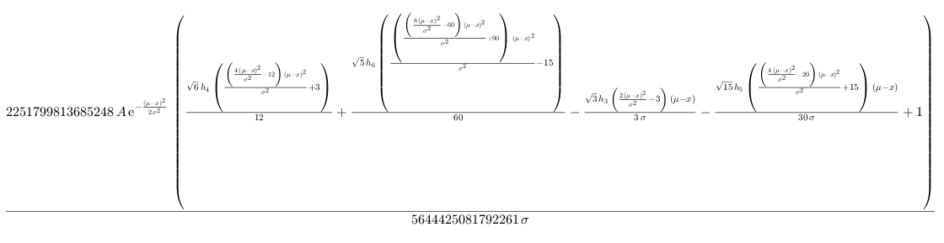
In case you were wondering what the fit equation looked like

Slide 10
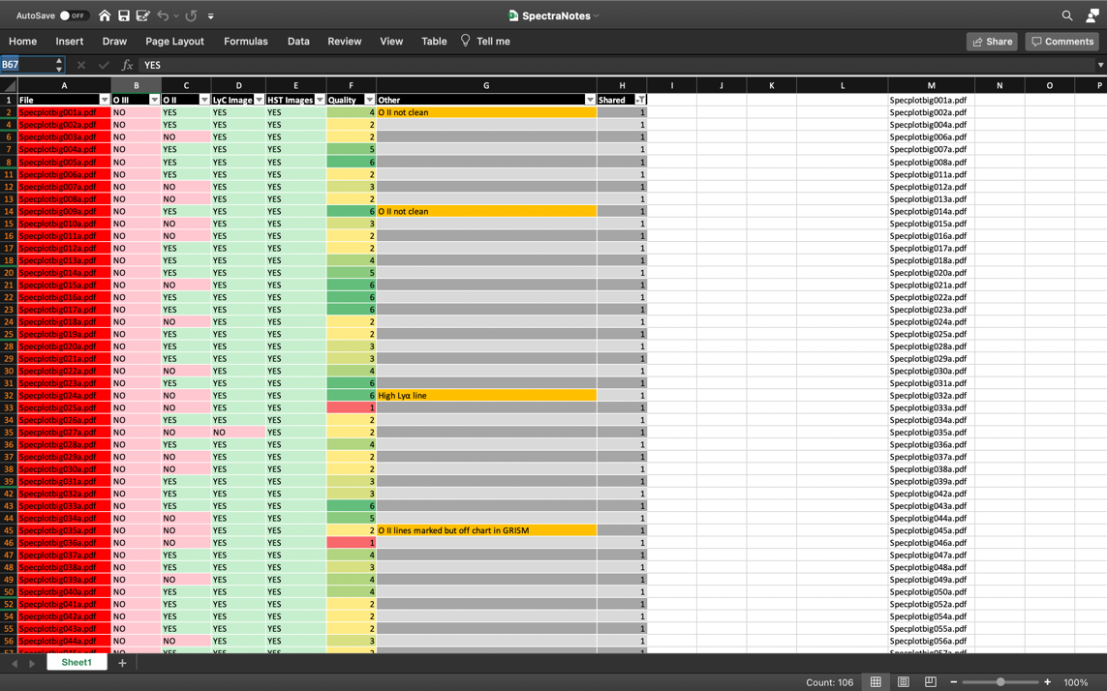
Method of cataloging

